Slide 1
The Boxer Rebellion
Nature, extent and impact of the Rebellion

Slide 2
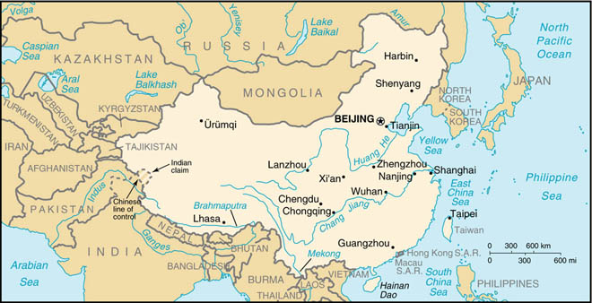

Slide 3
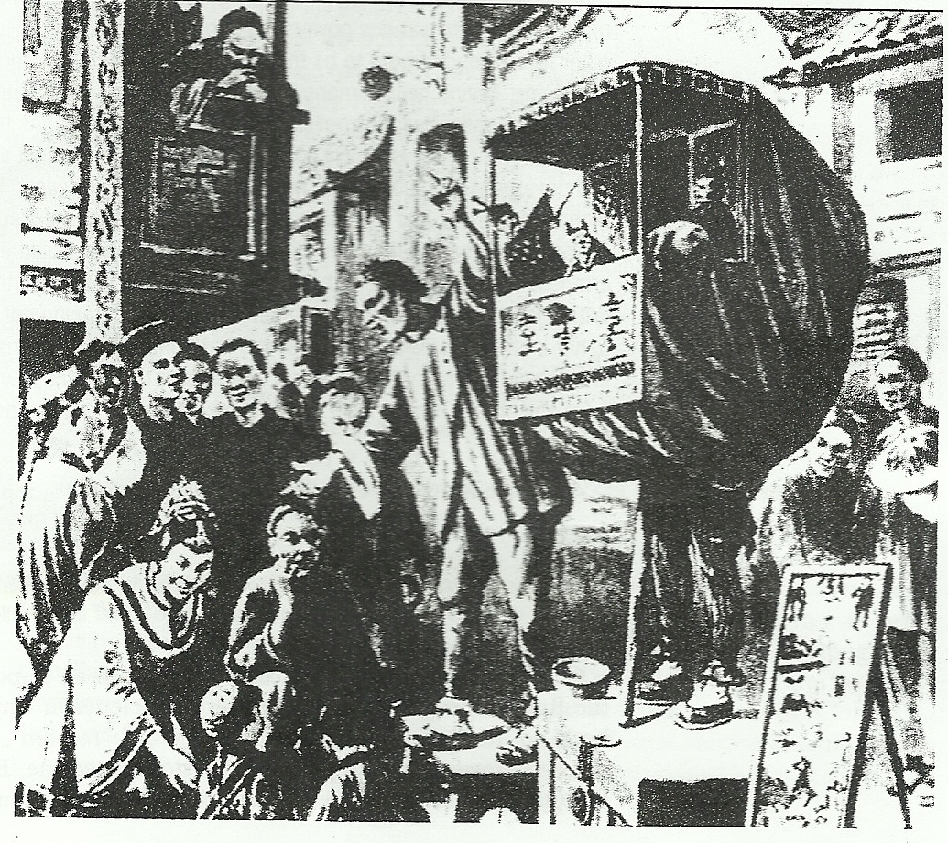
QUESTION: What does this image tell you?
Source: An illustration by a European correspondent of a glove-puppet show performed by Boxers to encourage recruiting.

Slide 4
Spectators
QUESTION: What does this image tell you?
Possibly a
boxer offical
A document revealing valuable information
Supporters
Propaganda
Boxer Officials trying to gain support

Slide 5
Why do you think this illustration was drawn?

Slide 6
What evidence in the illustration helps you know why it was drawn?

Slide 7
Write a question to the author that is left unanswered by the illustration:

Slide 8
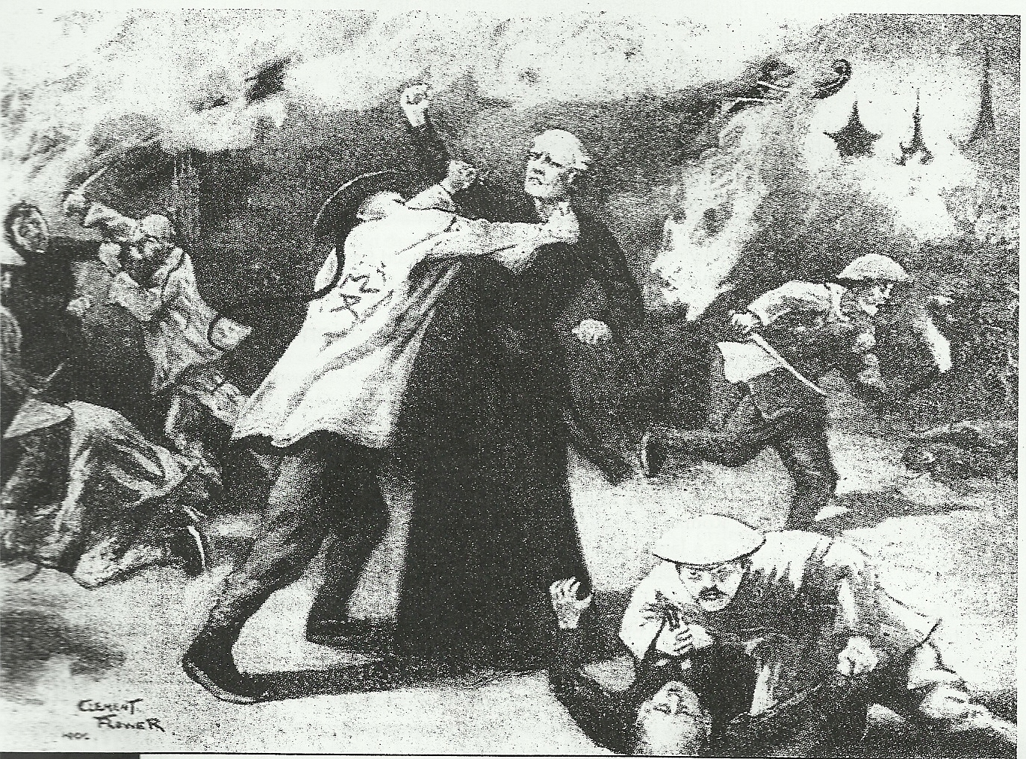
Source: A painting by a European artist in 1900 showing a Western view of the Boxers in action

Slide 9
Boxers attacking Europeans
Europeans taken as prisoners
Boxers shown as Ruthless
European perspective shows that the Boxers were vicious and didn’t hold back in their attacks

Slide 10
What questions does this illustration raise in your mind?

Slide 11
What features of the illustration indicate that it gives a Western point of view?

